Slide 1
Making Your Maps/Apps Accessible to Everyone
Klara Schmitt and Nicole Grams
Oct. 1, 2021

Slide 2


Speakers
Nicole Grams
Solution Engineer – State Government
Klara Schmitt
UX/UI Design Lead – ArcGIS Hub

Slide 3
Intro
What is web accessibility?
What is disability?
Why does accessibility matter?
What laws exist?

Slide 4
What is Web Accessibility?
Developing solutions that remove barriers to access
Creating perceivable, understandable, interactive experiences
Giving all people an opportunity to contribute
Encompasses all disabilities that affect access to the Web
Auditory Cognitive Neurological Physical Speech Visual
Benefits people without disabilities
People using different devices Older people with changing abilities People with slow Internet or limited bandwidth People with temporary disabilities or situational limitations

Slide 5
What is Disability?
 | Permanent | Temporary | Situational
Touch | One arm | Arm injury | New parent
See | Blind | Cataract | Distracted driver
Hear | Deaf | Ear infection | Bartender
Speak | Non-verbal | Laryngitis | Dental pain

Slide 6
Why Does Accessibility Matter?
Sources: CDC Disability Impacts All of Us, WHO: Assistive Technology, Bthechange, JimThatcher
61
million
2
billion
20%
25+
1 in 4 adults in the US (26%) have some type of disability
People worldwide needing at least one assistive product by 2030
Web traffic that could come from a person with a disability
Countries that have web accessibility laws and policies

Slide 7
Accessibility Laws & Guidelines
Web Content Accessibility Guidelines (WCAG)
  Benchmark for website accessibility standards
  Published by the Web Accessibility Initiative (WAI) of the World Wide Web Consortium (W3C)
  Intended for web content developers, web authoring tool developers, and others
Section 508
  Applies to all US federal agencies
  2017 Revision based on WCAG 2.0
Americans with Disabilities Act (ADA)
  Applies to state and local governments
  Title III prohibits discrimination on the basis of disability in activities within places of public accommodations
  In 2018, the Dept. of Justice reiterated that their interpretation that the ADA applies to websites

Slide 8
WCAG Conformance Levels
AAA
most stringent
AA
general standard
Addressing these guidelines aims to make content accessible to all audiences, but may not yet be achievable in some products/services
A
minimum
Addressing these guidelines makes content available for a wider range of people
Assistive technologies might be blocked from working correctly without these

Slide 9
Making Accessible Maps/Apps
Do-It-Yourself (DIY) Best Practices

Slide 10
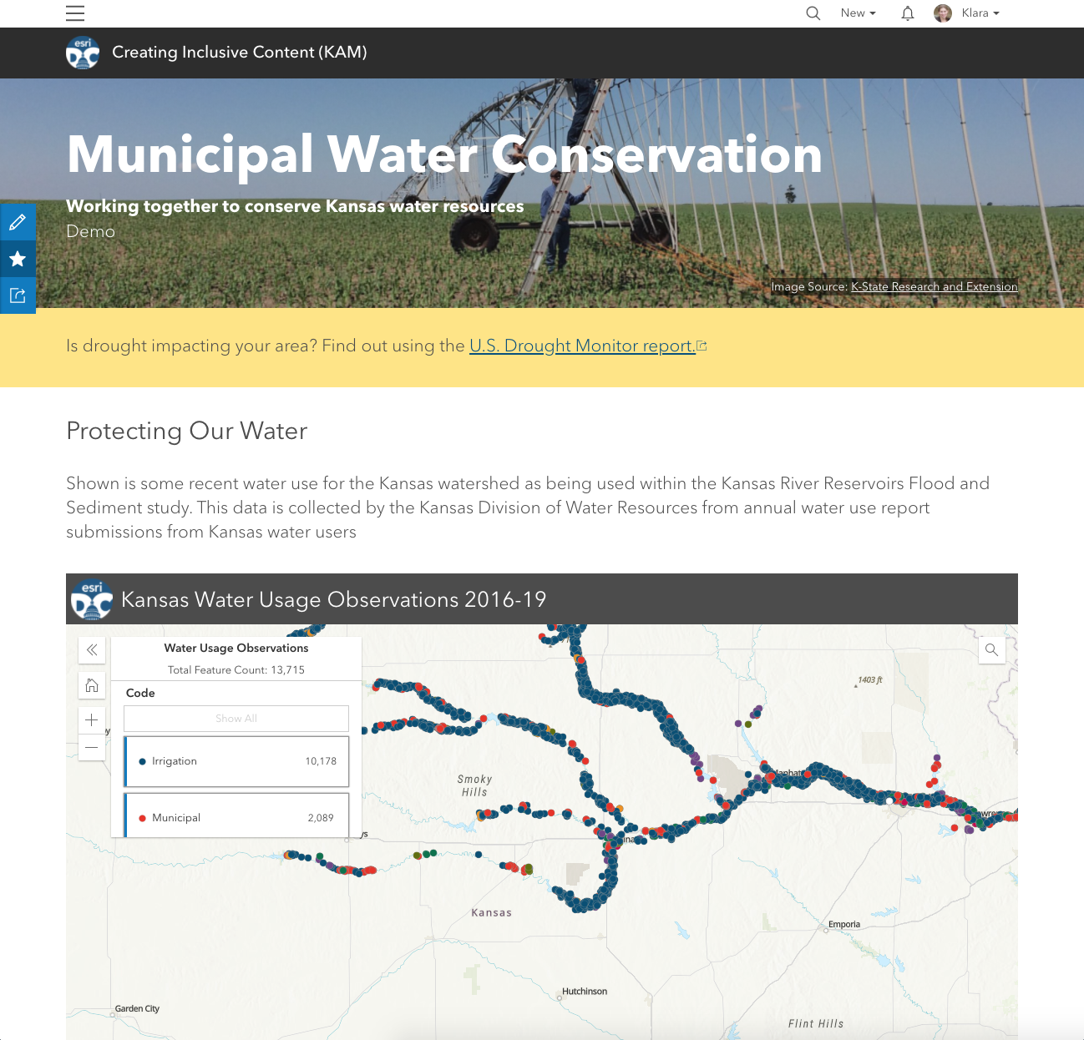



Site Scenario
Inform Kansas residents about drought conditions and water usage to encourage best practices for water conservation.
Apps involved:
ArcGIS Online
ArcGIS Hub
ArcGIS Instant Apps

Slide 11
What We Will Cover
Content – What you can do to make your headings, text, links, and embeddable content available to the widest audience
Images – How to write good text alternatives for images and icons, and knowing when it is not necessary
Color – Choosing an accessible color pallet and applying it as a theme; also setting a custom basemap
Testing – What you can do to test accessibility of your apps after customization

Slide 12
Content Structure
Do-It-Yourself (DIY) Best Practices

Slide 13
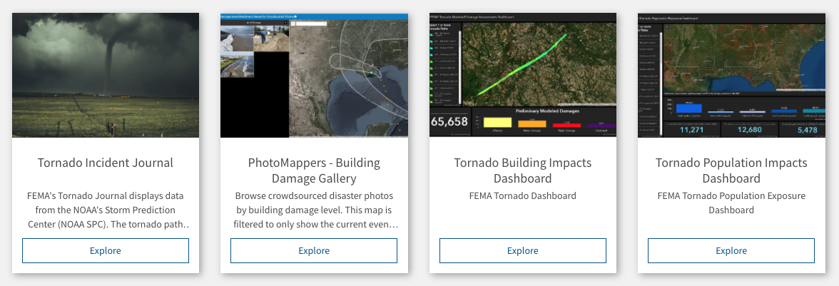
Hub Gallery Cards
DIY Content Structure
Related Guidelines: 2.4.4 Link Purpose, 3.2.1 On Focus

Slide 14

Link Best Practices
DIY Content Structure
Write meaningful link text
Avoid batches of similarly named links (if possible)
Indicate when links in new windows/tabs or keep them same tab
Enable link underlining in Hub (Site Settings > Interactions > Underlined Links)
GOOD
Is drought impacting your area? Find out using the U.S. Drought Monitor report.
AVOID
Is drought impacting your area? Click here to see if you are affected.
GOOD
Is drought impacting your area? View drought dashboard (opens new tab).
AVOID
Is drought impacting your area? View drought dashboard.
Related Guidelines: 2.4.4 Link Purpose, 3.2.1 On Focus

Slide 15
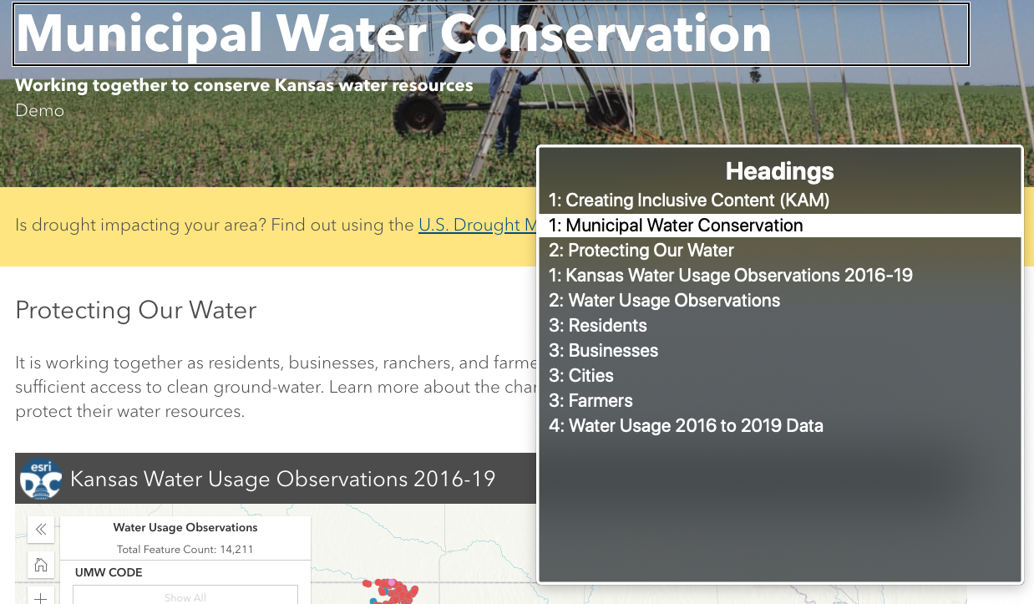
Heading Best Practices
DIY Content Structure
Page should have at least one h1 heading
Heading text should be informative,
but succinct
Headings should (ideally) be nested
  Not always possible
Do not use headings to increase font size
Related Guidelines: 2.4.1 Bypass Blocks, 2.4.6 Headings and Labels

Slide 16
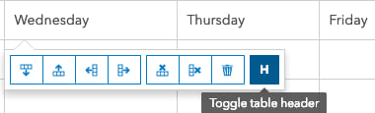
Labeling Best Practices
DIY Content Structure
Content embedded by iframe needs iframe title describing content
  Hub Video Card is automatic, uses video title
  Hub Social Media Card is automatic, uses source of content
  Hub Iframe Card needs manual entry
Tables should be used for data not layout
  Tables should have a table header row
Related Guidelines: 1.3.1 Info and Relationships, 2.4.6 Headings and Labels

Slide 17
Navigation Best Practices
DIY Content Structure
Web pages should be titled (seen in browser tabs)
  In Hub, this can be set on a site by going to Settings > About and filling out the Name field
Use consistent navigation
  Links that are repeated on multiple web page menus should stay in relatively the same order
There is more than one way to find content
  Easiest way: have a navigation menu (links) & a search bar always present
  Enable search in Hub: Site Settings > Interactions > Global Navigation
Related Guidelines: 2.4.2 Page Titled, 2.4.5 Multiple Ways, 3.2.3 Consistent Navigation

Slide 18
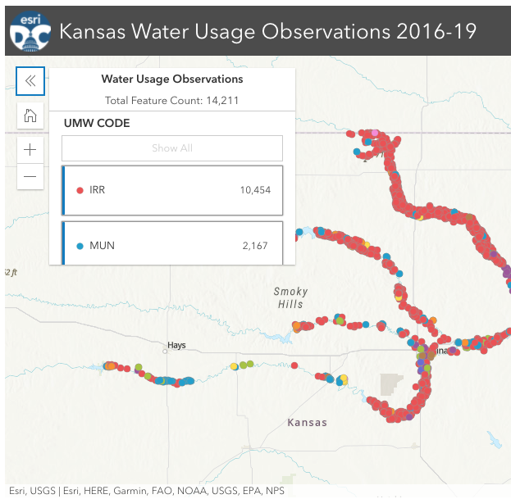
Keyboard Navigation
Interlude
Applies to two main audiences
  Sighted individuals navigating by keyboard or switch-device
  Individuals who are using a screen-reader; maybe due to being non-sighted or low-vision
Sighted Keyboard Usage
  Only links and form elements receive focus
  Controls should have a visible focus state and it should not be strictly color-based
Screen-reader Usage
  All page elements should be read, unless hidden
  But this does not correlate to visible focus state
Can you see which control has keyboard focus on the Instant App?
Related Guidelines: 2.4.7 Focus Visible, 1.4.1 Use of Color

Slide 19
Multimedia
DIY Content Structure – What Not to Do
Avoid auto-rotating content
  A popular feature request in Hub is carousels – the reason there is no carousel yet is they are very hard to make accessible
  Communicating state about auto-rotating content to someone using a screen-reader without losing their place in the page and simultaneously giving them a way to pause or get out of the content isn’t easy
Avoid auto-playing videos (or gifs)
  Any content lasting longer than 5 seconds requires pause, stop, play controls
Related Guidelines: 2.2.2 Pause, Stop, Hide, 2.3.1 Three Flashes or Below Threshold

Slide 20
Images, Background Images, & Icons
Do-It-Yourself (DIY) Best Practices

Slide 21
Images
I hear ALT TEXT a lot. What does that mean?
Alt Text is short-hand for alternative text. Text alternatives should be used to convey relevant information about visual content.
Is ALT TEXT the same as an image ALT ATTRIBUTE?
No. Images displayed by the <img> tag are the only HTML elements that support the alt attribute. These are typically: .PNG, .JPEG, .JPG
DIY Text Alternatives for Raster Images
Images <img> should have an alt attribute that contains a succinct text description of what is displayed in the image
  When alt attributes are omitted, then assistive technologies will read the filename, which isn’t usually desirable
Images of text should be avoided, unless the image is a logo or a screenshot where inline text cannot be avoided
Related Guidelines: 1.1.1 Text Alternatives, 1.4.5 Images of Text

Slide 22
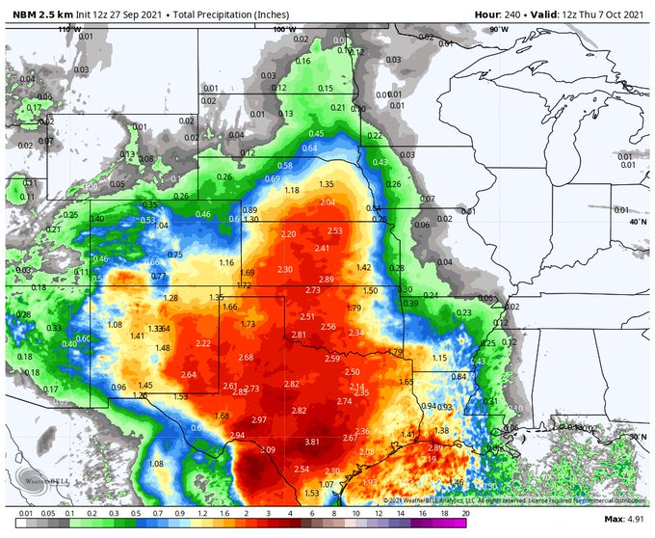
Writing Alt Text
DIY Text Alternatives for Raster Images
Good alternative text should
  Describe the image succinctly
  Not start with “Image of…” or “Picture of…”
  as the img element will communicate this to assistive technologies
  Use details relevant to the context
  If using an image as a link, describe link destination rather than image (eg. “Go to NOAA local forecast”)
Image courtesy of @MattLabenzwx Twitter
<img src=“photo1.jpg” alt=“10-day precipitation model with 2.3-inch average accumulation for mid-state Kansas”>
Related Guidelines: 1.1.1 Text Alternatives

Slide 23

Background Images (1/2)
Do decorative images need alternative text?
No. When an image is decorative, only present for visual interest, or would be redundant information to surrounding text, it’s best to hide the image.
If you have a decorative image that is not a background image, the alt attribute should be set to empty.
<img src=“swirl.png” alt=“” />
DIY Text Alternatives for Background Images
Background images are not actually semantic images
They are not communicated as images to screen-readers
If a user has CSS disabled, background images will not render at all
They are usually considered decorative
Related Guidelines: 1.1.1 Non-Text Content, 1.4.5 Images of Text

Slide 24
Background Images (2/2)
a little more technical
DIY Text Alternatives for Background Images
Background images may occasionally be used instead of regular images as they can handle device resizing better
Extra work is necessary to communicate this to assistive technologies
The HTML container displaying the background-image must have an aria role=“img” added to it and an aria-label
  StoryMaps does this on their row background images
aria-label does the same thing as an alt attribute, except it can be used on non-image objects
Related Guidelines: 1.1.1 Non-Text Content, 1.3.1 Info and Relationships

Slide 25
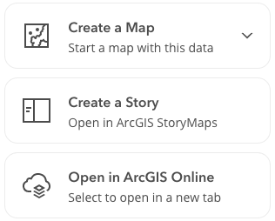
SVG Images & Icons
DIY Text Alternatives for Vector Images
Icons are usually vector images
Vector images are useful because they scale big or small without losing detail or getting blurry
Icons can be decorative too & should be hidden from assistive technologies if they will be redundant labeling
aria-label can be used for CSS icon fonts and/or SVG objects as a text alternative
Related Guidelines: 1.1.1 Non-Text Content, 1.3.1 Info and Relationships

Slide 26

SVG Object
a little more technical
DIY Text Alternatives for Vector Images
<svg xmlns="http://www.w3.org/2000/svg" viewBox="0 0 24 24”
aria-label=“activity” role=“img”><title>activity</title><path d="M19 13h-2.15l-3.35 9.213-6-16.5L4.85 13H1v-1h3.15L7.5 2.787l6 16.5L16.15 12H19a2.496 2.496 0 0 0 0 1zm2.5-2a1.5 1.5 0 1 0 1.5 1.5 1.502 1.502 0 0 0-1.5-1.5z"/><path d="M0 0h24v24H0z"/></svg>
SVG objects do not support the alt attribute
W3C specification says to use <title></title>
  Not all screen-readers do well with title tags
  In my experience, aria-label is more widely effective
  Do not use both (code example is for demonstration only)
NVDA requires role=“img” on SVG objects to recognize them
Related Guidelines: 1.1.1 Non-Text Content, 4.1.2 Name, Role, Value

Slide 27

Hiding an SVG Object
a little more technical
DIY Text Alternatives for Vector Images
<svg xmlns="http://www.w3.org/2000/svg" viewBox="0 0 24 24”
aria-hidden=“true” role=“img”><path d="M19 13h-2.15l-3.35 9.213-6-16.5L4.85 13H1v-1h3.15L7.5 2.787l6 16.5L16.15 12H19a2.496 2.496 0 0 0 0 1zm2.5-2a1.5 1.5 0 1 0 1.5 1.5 1.502 1.502 0 0 0-1.5-1.5z"/><path d="M0 0h24v24H0z"/></svg>
To mark a SVG as decorative or hidden, use aria-hidden=“true”
  Do not use aria-hidden=“false” (counterintuitive, I know)
  aria-hidden=“false” has unstable screen-reader support
Related Guidelines: 1.1.1 Non-Text Content, 1.3.1 Info and Relationships

Slide 28
Color, Theming, & Maps
Do-It-Yourself (DIY) Best Practices

Slide 29
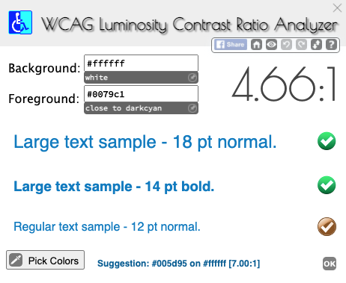
Color Contrast (1/2)
DIY Color Contrast Requirements
Text must have a contrast radio of 4.5:1 unless considered large text, a logo, decoration or part of an inactive component interface (eg. disabled button.)
Large text must have a contrast radio of 3:1
Non-text content (symbols, icons) must have a contrast radio of 3:1
Related Guidelines: 1.4.3 Contrast (Minimum), 1.4.11 Non-Text Contrast

Slide 30
Color Contrast (2/2)
DIY Color Contrast Testing Tools
Need to check existing colors?
WebAIM Contrast Checker
WCAG Luminosity Contrast Ratio Analyzer (Chrome Plugin)
Want help generating an accessible color pallet?
http://colorsafe.co/
https://colororacle.org/
Related Guidelines: 1.4.3 Contrast (Minimum), 1.4.11 Non-Text Contrast

Slide 31
Theming
DIY Accessible Color Pallets in Esri Applications
ArcGIS Online
Provides range of accessible out-of-the-box themes for home site
Offers theme builder for home page with built-in accessibility warnings
ArcGIS Hub
Inherits shared organization theme set in Online (if available)
Provides accessible out-of-the-box Calcite theme
Offers theme builder for customization (use with contrast checking tools)
ArcGIS Instant Apps
Inherits shared organization theme set in Online (if available)
Offers dark and light pre-selected themes
Related Guidelines: 1.4.3 Contrast (Minimum), 1.4.11 Non-Text Contrast

Slide 32
Demo: Applying an Accessible Theme

Slide 33
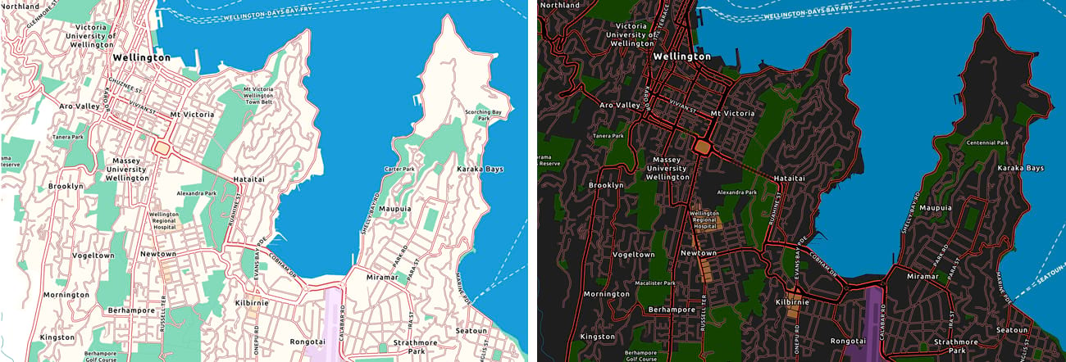
Accessible Basemaps (1/2)
DIY Setting an Accessible Basemap
Related Guidelines: 1.4.3 Contrast (Minimum), 1.4.11 Non-Text Contrast

Slide 34
Accessible Basemaps (2/2)
DIY Setting an Accessible Basemap
Andy Skinner (esri) has created basemaps that adhere to WCAG-AA standards; they are now part of the ArcGIS Living Atlas of the World.
  Light Basemap
  Dark Basemap
  Gray Basemap
  Or search Google for “ArcGIS blog accessible basemap”
These can be used in Map Viewer (web maps, scenes), Instant Apps, StoryMaps (express maps, map tours), and Hub sites.
  To use, add to your Online basemap gallery, then set in Hub under Site Settings > Custom Basemap or in Story Maps under Add Map.
Related Guidelines: 1.4.3 Contrast (Minimum), 1.4.11 Non-Text Contrast

Slide 35
Demo: Tying it all Together
Setting an accessible basemap & VoiceOver demo

Slide 36
Automated Testing
Do-It-Yourself (DIY) Testing

Slide 37
Testing Tools
DIY Accessibility Testing
Automated accessibility testing tools
  aXe plugin (Chrome, Firefox, Edge, Android)
  Lighthouse plugin (Chrome)
Manual Testing
  Navigating as a sighted keyboard individual
  Navigating with a screen-reader
    VoiceOver | NVDA | JAWS | Narrator
  Navigating with voice recognition technology
    Dragon Naturally Speaking, Speech Recognition Anywhere (Chrome plugin),
    Voice Control (MacOS Catalina), Voice Recognition (Windows 10)
Related Guidelines: 1.4.3 Contrast (Minimum), 1.4.11 Non-Text Contrast

Slide 38
Resources
Esri Accessibility
  Accessibility Conformance Reports
  Resources (articles, blogs, videos)
  Common Questions
Esri Community – Accessibility
  Questions
  Documents
  Blog
Esri's Commitment to Accessibility
  EsriAccessibility@esri.com
Notes:
NOTE TO PRESENTER: Add in your own resources related to the webinar

Slide 39
Q&A

